Slide 1


DSO 568 - Healthcare Analytics
Stroke Prediction
Modeling
Dec 2, 2024

Slide 2






Meet the Team
Campbell Duncan
Jnana K P
Lindsay Yan
Lucian Deng
Marliese Sanabria
Zoha Akhtar

Slide 3
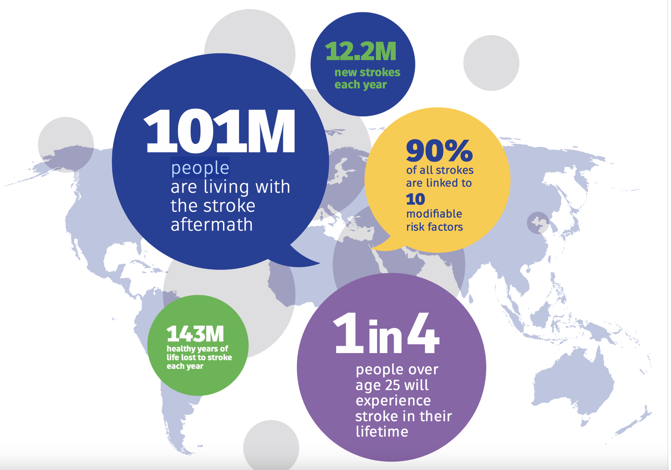
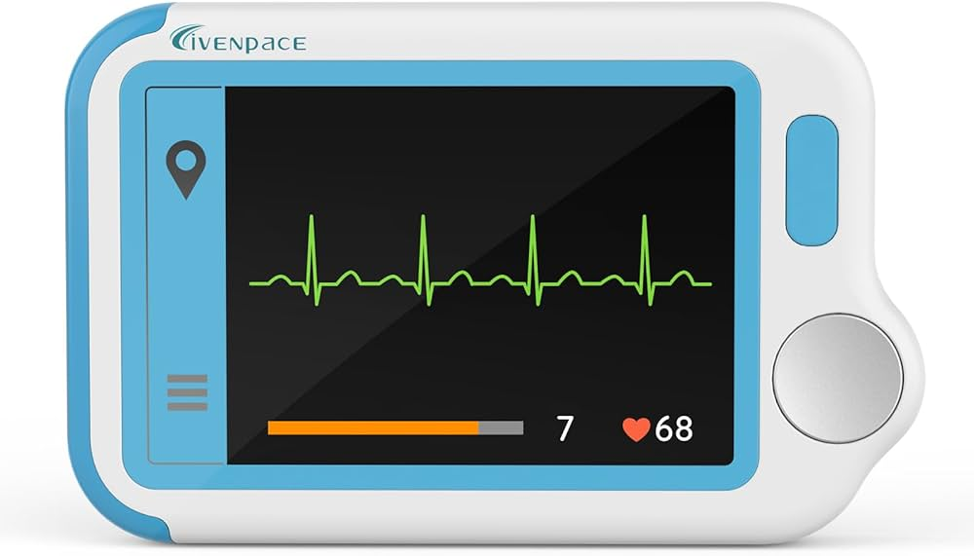
Problem Statement:
Stroke is a leading cause of death and long-term disability globally, with millions affected annually.
Lack of predictive tools limits timely identification of high-risk individuals, delaying preventive care.

Slide 4


Why It Matters?
Clinical Impact: Reduces mortality and improves recovery through early intervention.
Economic Burden: Preventive care costs are significantly lower than stroke treatment.
Operational Efficiency: Enables better resource allocation in healthcare systems.

Slide 5
Solution Approach:
Cleaning
Pre-Process
Model Selection
Evaluation
Exploration
EDA
Classification
Metrics
- Relatively small dataset
- Class imbalance from lack of stroke patients
- Dropping outliers and handling missing values
- Multiclass features needed to be encoded
- Multiclass features one hot encoded
- Binary features addressed
- Statsmodels used to find statistically significant features for future model engineering
- Statsmodels Logit for feature selection
- Scikit Learn Logistic Regression as base model
- Decision tree, random forest, XGBoost as advanced models to compare
- Ensemble Random Forest & XGBoost as final model to compare
- AUC ROC curves
- Recall of class 1 predictions
- Care a lot about false negatives in stroke patients
- F1 Score is also a good indicator since it combines recall and precision

Slide 6
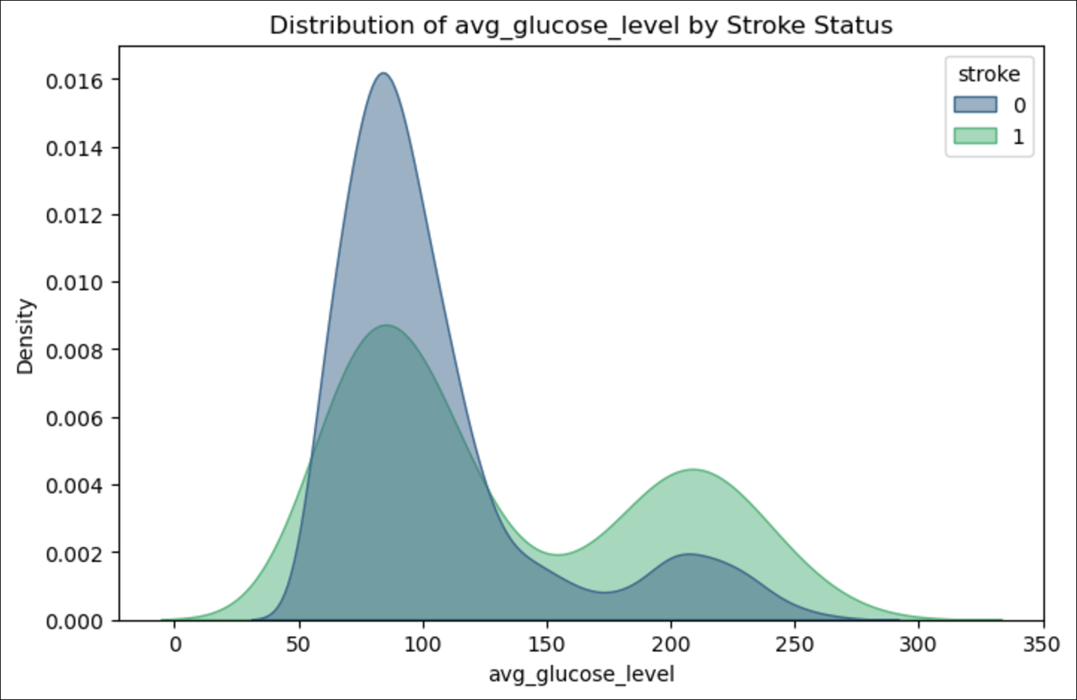
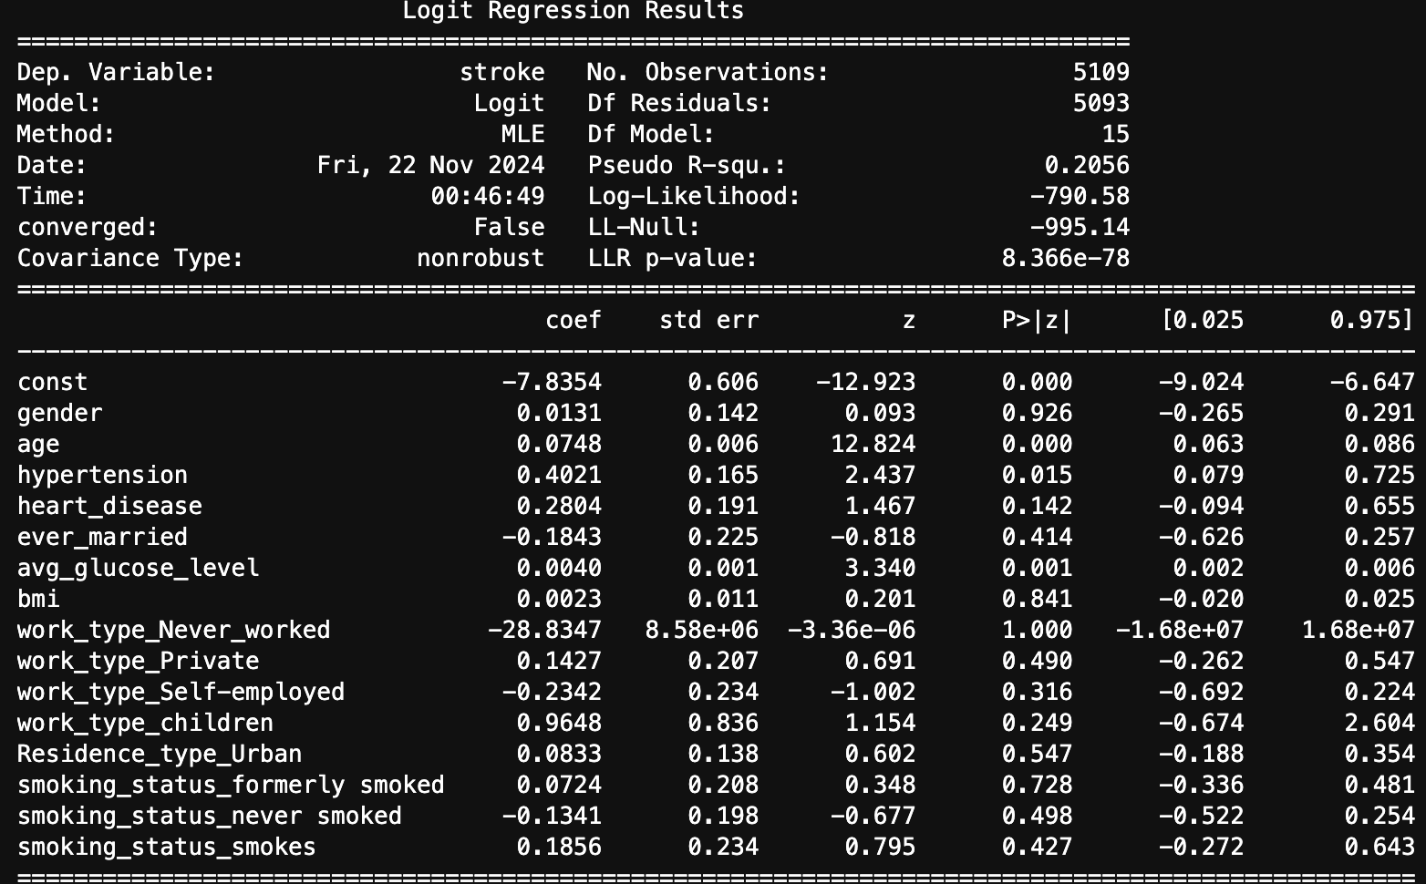
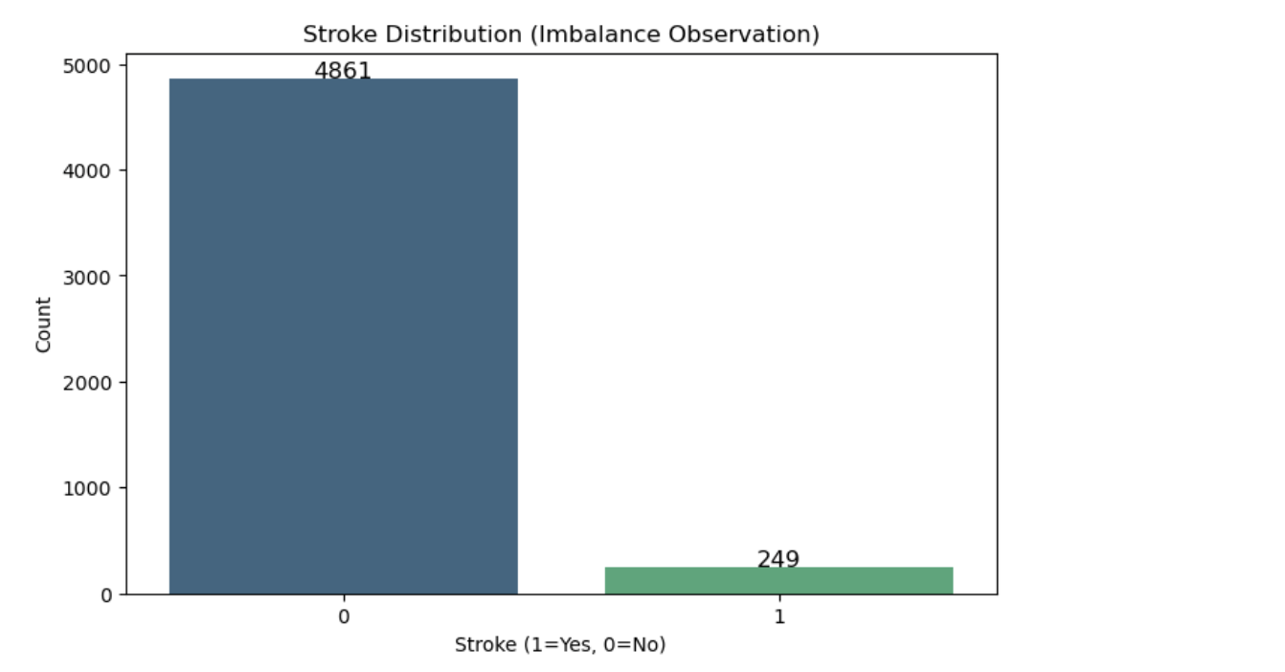
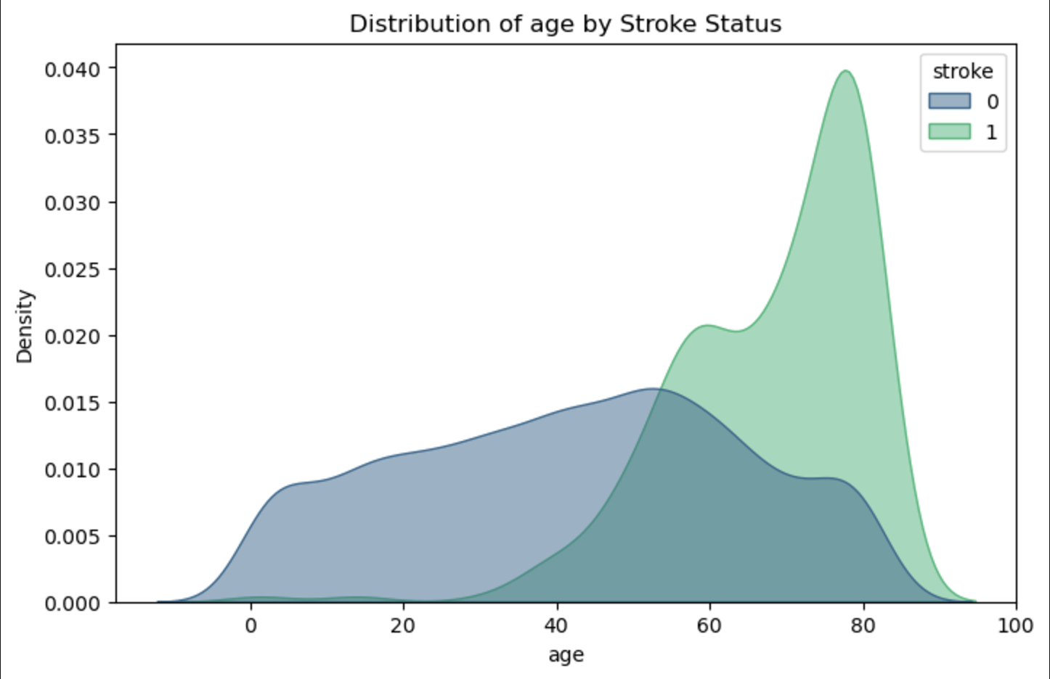

Slide 7
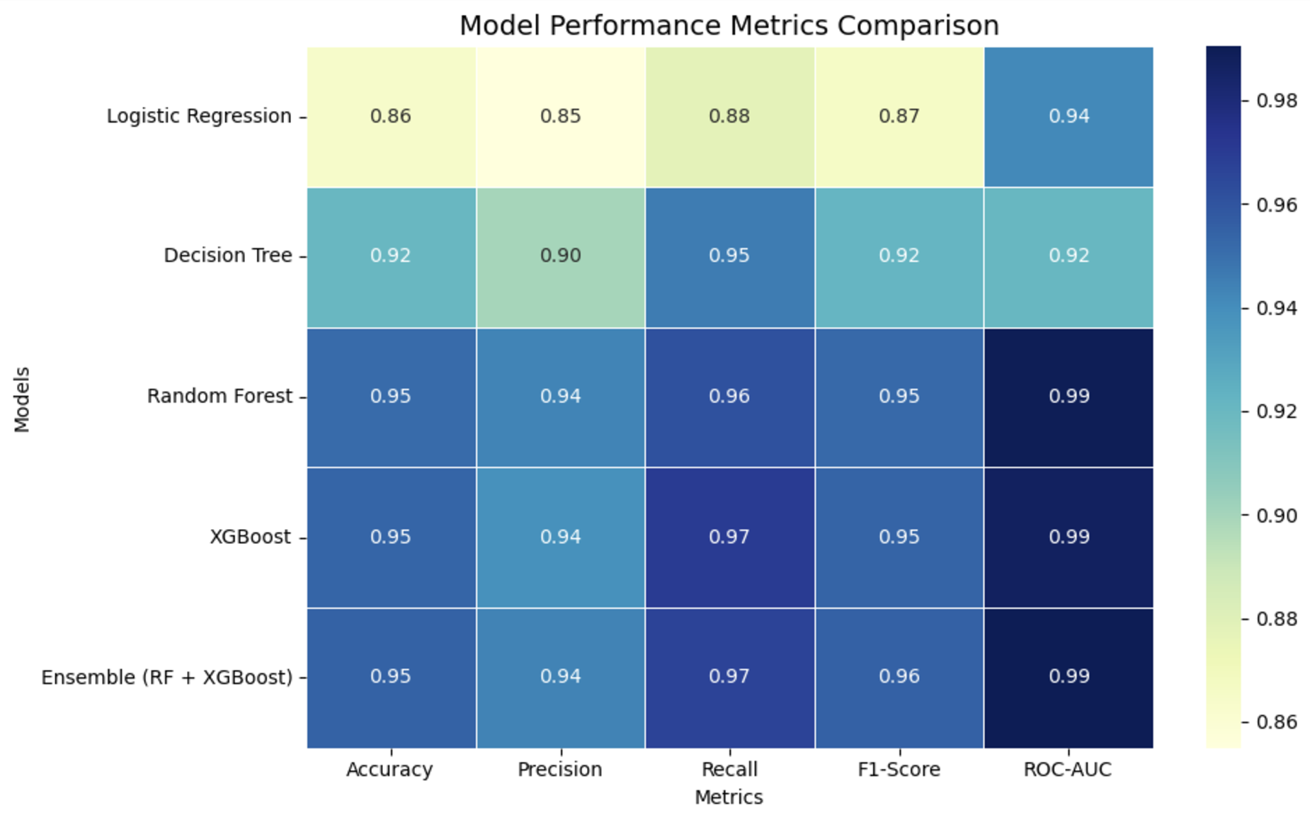

Slide 8
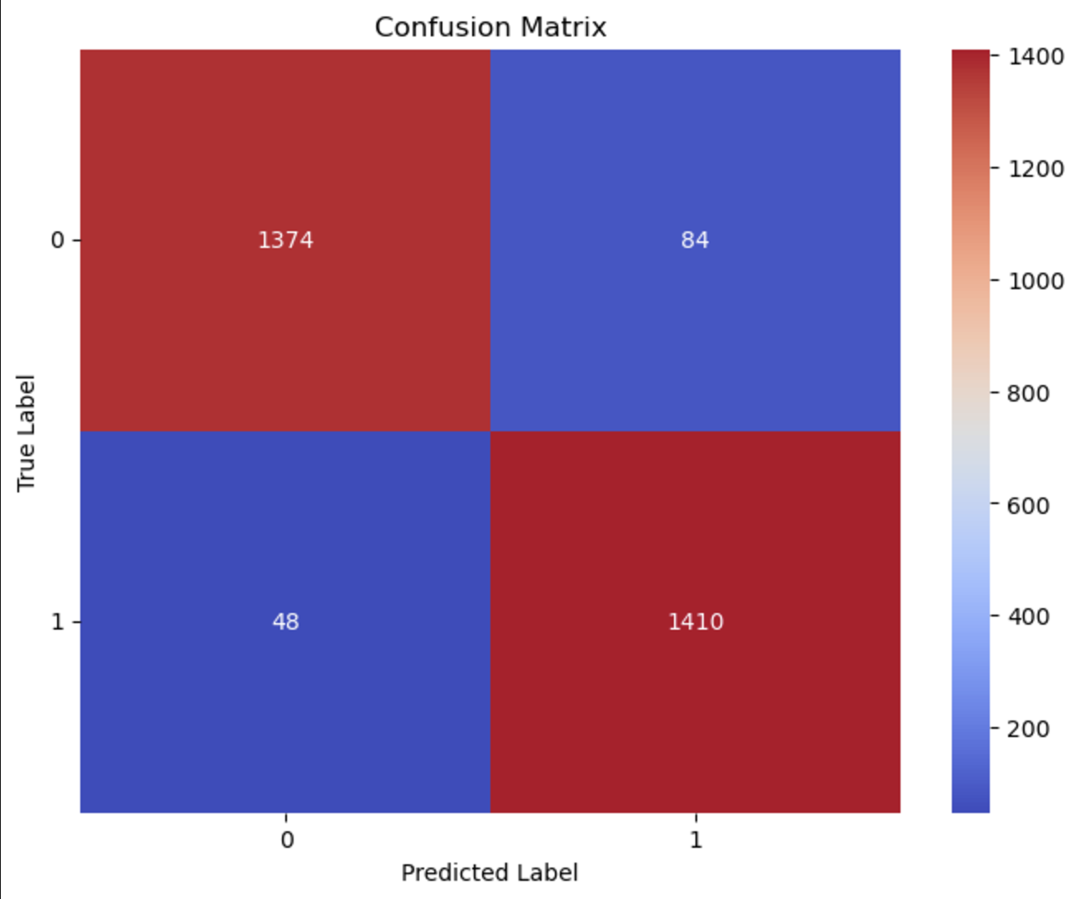
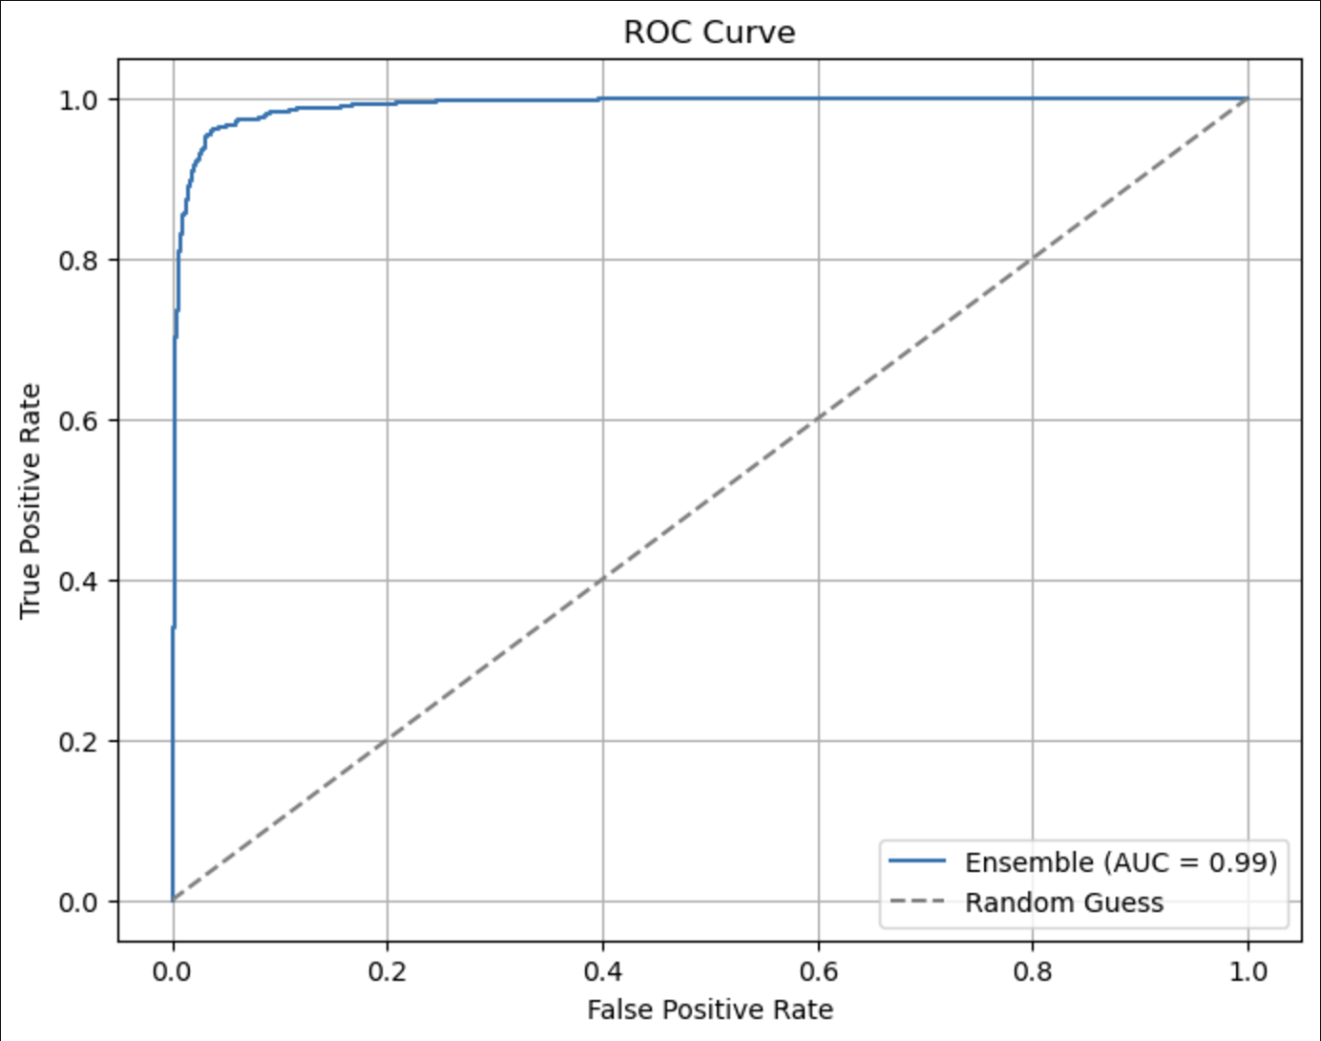

Slide 9
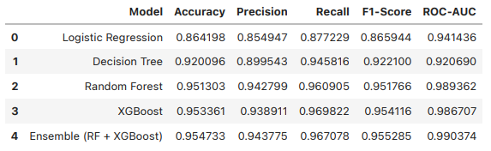
Performance Metrics:
Logistic Regression: Initially selected due to the binary nature of the target variable and to test the significance of 12 features. Class imbalance led to low recall for stroke cases, which was improved using the SMOTE technique, enhancing precision, recall, and accuracy.
Model Iteration: To further improve performance, multiple models were tested.
XGBoost: Increased recall but slightly dropped precision compared to the baseline model.
Ensemble: Combining it with XGBoost improved both precision and accuracy significantly, with a minor impact on recall.
Best Performing Model: The combination of XGBoost and Random Forest achieved the highest accuracy (95.47%) and ROC-AUC score (99.04%), making it the most robust model for stroke prediction.

Slide 10
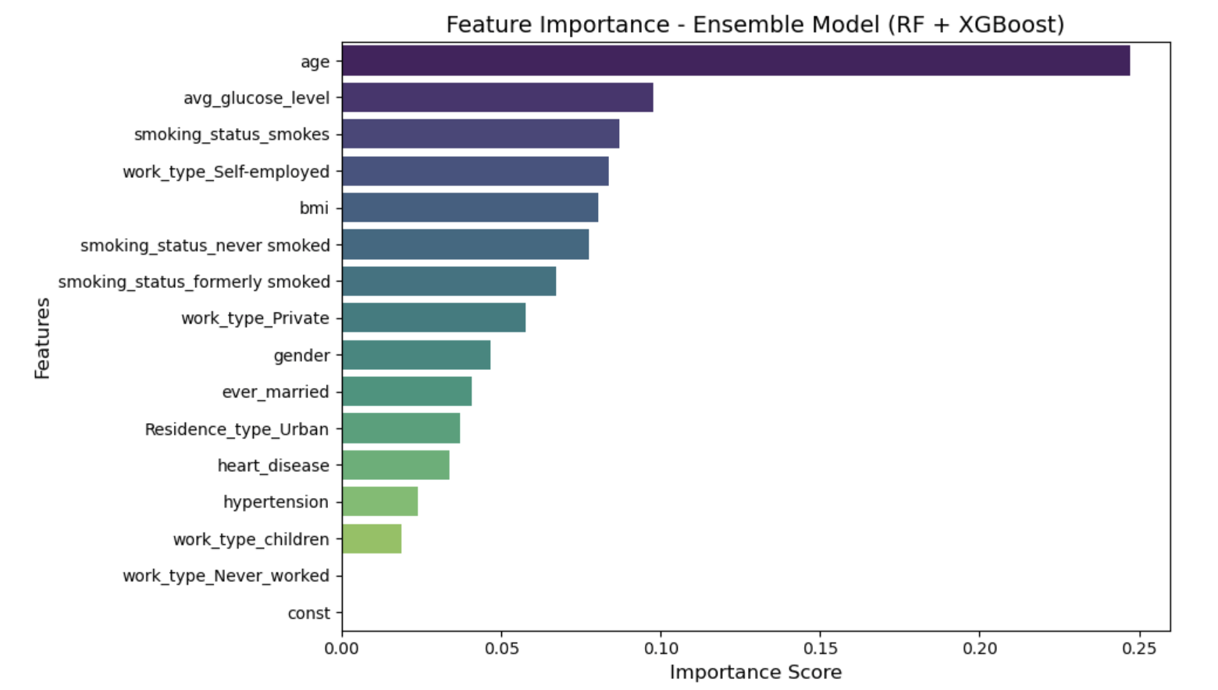
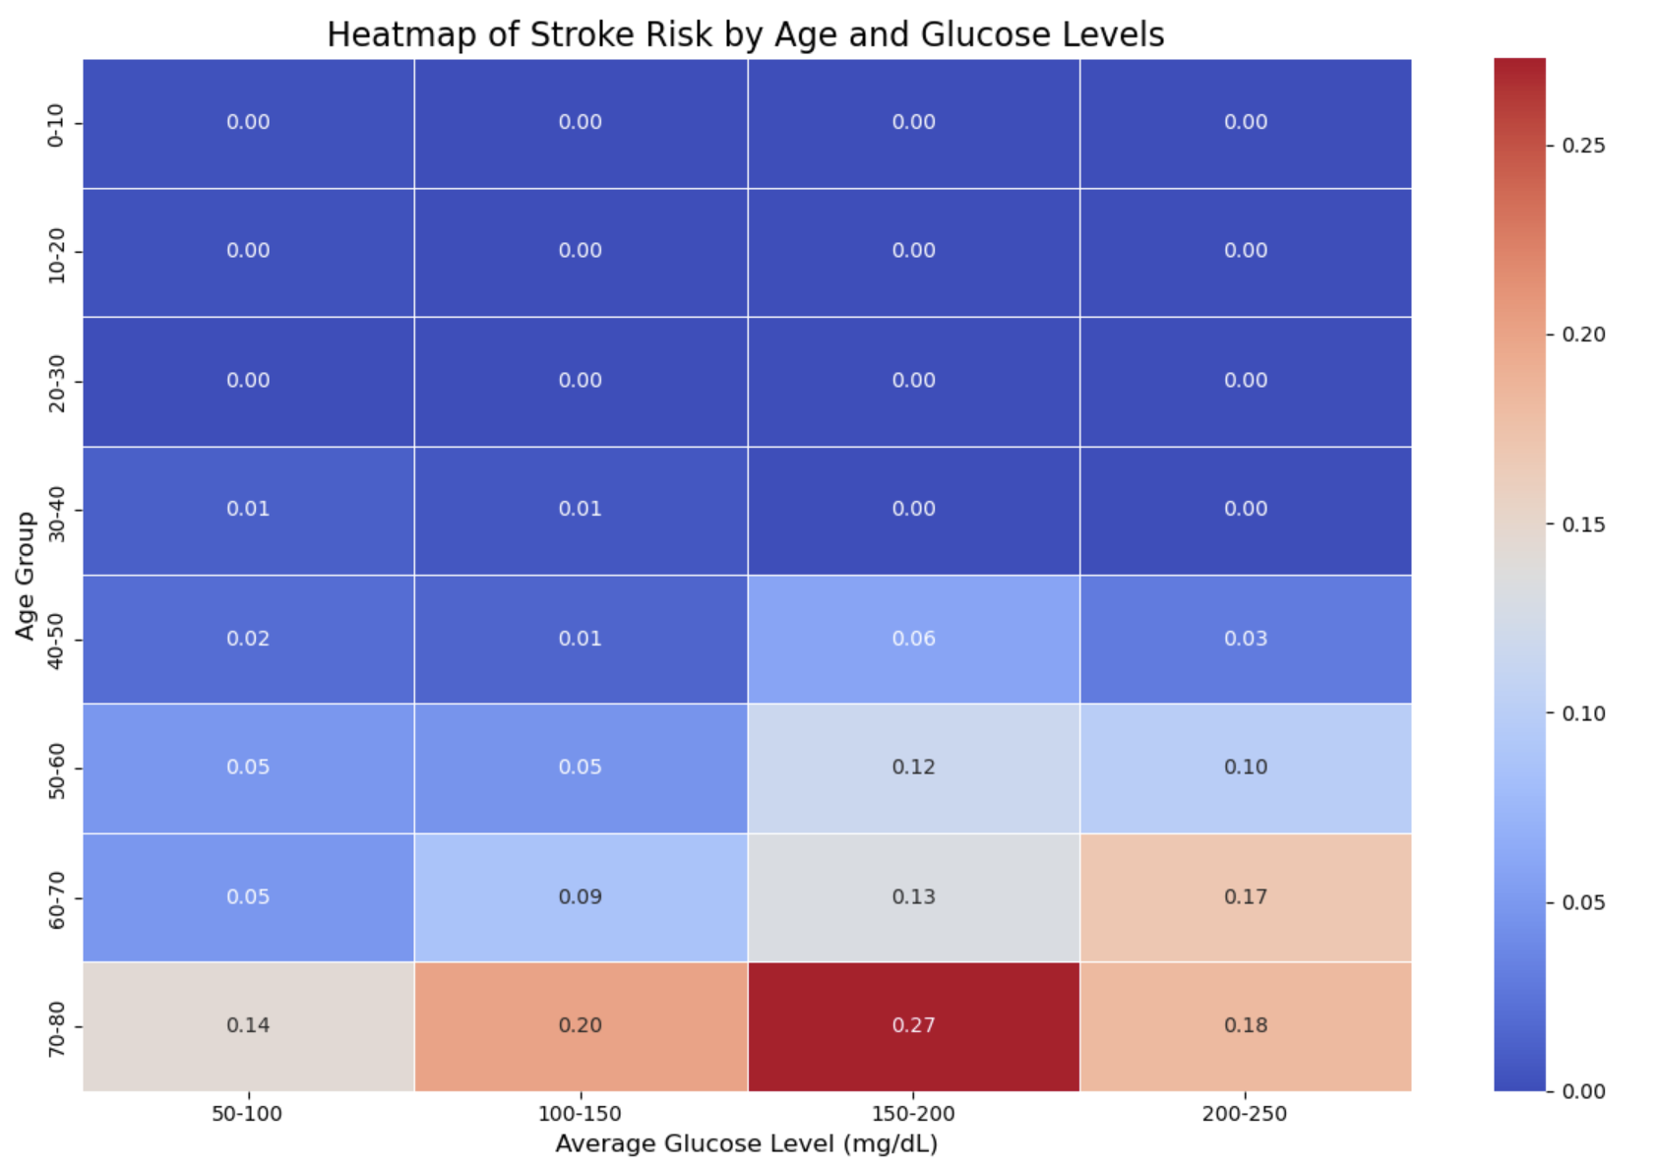
Key Predictors:
Age: Strongest predictor; individuals above 60 are at higher risk.
Glucose Levels: Levels >150 mg/dL strongly linked to strokes.
Combined Effects:
Older age and high glucose levels together show amplified risks
Model Insights:
SMOTE Effectiveness: Balanced the dataset, improving recall for stroke cases.
Ensemble Model Performance: 95.47% accuracy, 99.04% ROC-AUC. Achieved the best balance between precision and recall.
Key Insights:

Slide 11
Business/Clinical Recommendations:
Targeted Screening and Monitoring Programs:
Age-Based Prioritization:
Implement stroke risk screenings for individuals over 60 during routine health check-ups, prioritizing those with comorbid conditions such as hypertension.
Advocate for healthcare policies that promote subsidized screenings and preventive programs for individuals over 60 or with glucose levels above 150 mg/dL, aiming to reduce systemic stroke burdens.
Blood Glucose Monitoring:
Establish regular glucose level monitoring programs for high-risk groups, focusing on patients with levels exceeding 150 mg/dL. Encourage these patients to maintain logs for regular evaluation.
Early Intervention:
For high-risk individuals, provide proactive treatment strategies such as blood clot prevention drugs and recommend consultations with specialists like cardiologists.
Develop care plans for patients exhibiting both high glucose levels and advanced age. Include frequent monitoring, lifestyle adjustments, and medical interventions like blood pressure and glucose management.

Slide 12
Future Recommendations:
Additional Data Sources:
Incorporate real-time patient monitoring data (e.g., wearable devices, EHRs).
Expand the dataset with variables like cholesterol, physical activity, and stress levels.
Use data from diverse populations to improve model generalizability.
New Model Architectures:
Experiment with deep learning models (e.g., Neural Networks).
Implement AutoML tools for hyperparameter optimization.
Ongoing Monitoring:
Deploy a system for real-time model feedback and periodic retraining with new data.
Monitor model fairness and adjust for emerging biases.
Include explainable AI methods to increase trust in clinical decision-making.

Slide 13
Thank You!

